Slide 1
Linux Introduction
Manoj (Manu)

Slide 2
What is Linux
Linux is a widely-used open-source operating system.
What is OS ?
An Operating System (OS) is a software which acts like an interface between a computer user and computer hardware. It takes command from the user, perform the required task and returns the result to the user.
An operating system performs all the basic tasks like file management, memory management, process management, handling input and output, and controlling peripheral devices such as disk drives and printers.
What is Linux Used For?
Linux is mostly used in servers, cloud computing, supercomputers, embedded systems, and developer environments. Its reliability, scalability, and security make it the backbone of web hosting, data centers, and IoT devices
Linux is a crucial skill for cloud and DevOps roles, as it powers most cloud environments and containerized application

Slide 3

Linux® is an open-source operating system (OS) created by Linus Torvalds in 1991.
Today, it has a massive user base and is used in the world’s 500 most powerful supercomputers.
Users gravitate toward it for its versatility and security capabilities, among other reasons.
Benefits of Linux
Versatility. Linux is flexible enough to adapt for virtually any need you can imagine. It powers all kinds of technology, from small, data-gathering edge devices to complex, cloud-native applications that the world’s largest companies depend on.
Security. Linux’s modularity is especially beneficial in your approach to security, because you can monitor every aspect of the OS. SELinux has been a part of the Linux kernel since 2003, giving administrators visibility into and granular control over user access and application permissions.
Community. A worldwide community of practice around Linux has existed for decades, and thousands of smaller communities have formed around specific projects. That means there’s always someone willing to share ideas, troubleshooting tips, and new innovations.

Slide 4
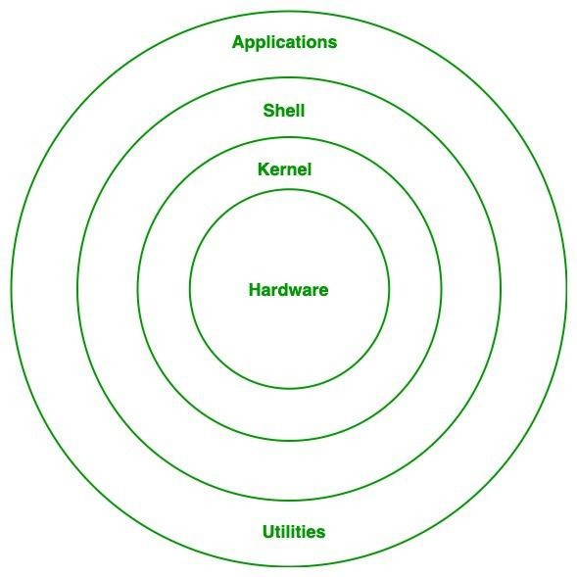
Linux Architecture
Hardware: Hardware is physical hardware components of computer
Kernel: The base component of the OS. Without it, the OS doesn’t work. The kernel manages the system’s resources and communicates with the hardware. It’s responsible for memory, process, and file management.
Shell: is a special user program that provides an interface for the user to use operating system services.
Applications:. Applications includes system software, application software, programming languages etc. Most Linux distributions offer a central database to search for and download additional applications.
Utilities: are essential tools in Linux that help manage and configure the system. They handle tasks like installing software, setting up networks, monitoring performance, and managing users. These tools make system administration easier and keep the system running smoothly.
Notes:
Shell accepts human-readable commands from users and converts them into something which the kernel can understand. It is a command language interpreter that executes commands read from input devices such as keyboards or from files

Slide 5
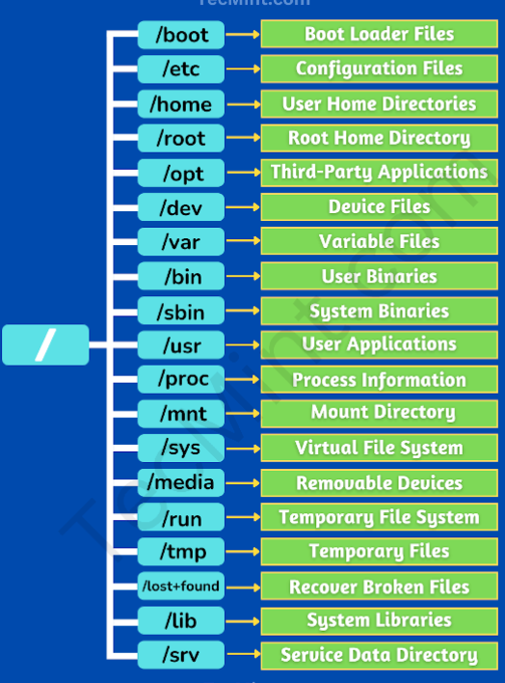
Notes:
The Linux directory structure is organized in a hierarchical tree format, with the root directory (/) at the top. Here are the main directories and their purposes:
/ (Root) – The top-level directory that contains all other directories.
/bin – Essential system binaries (commands like ls, cp, mv).
/boot – Files needed to boot the system (like the kernel and bootloader).
/dev – Device files (representing hardware like disks and USBs).
/etc – Configuration files for the system and applications.
/home – User directories (e.g., /home/user).
/lib – Shared libraries required by system programs.
/media – Mount points for removable media (USBs, CDs).
/mnt – Temporary mount point for filesystems.
/opt – Optional software and third-party applications.
/proc – Virtual directory for system and process information.
/root – Home directory for the root user.
/sbin – System binaries for administration (like shutdown, fdisk).
/srv – Data for services (like web servers).
/sys – System information related to hardware.
/tmp – Temporary files (cleared on reboot).
/usr – User-related programs and libraries (/usr/bin, /usr/lib).
/var – Variable files (logs, cache, mail queues).

Slide 6
How is the Linux Operating System Used
The Linux operating system is widely used across various domains due to its flexibility, security, and open-source nature:
Servers and Hosting: Powers web servers, cloud infrastructure, and database management systems.
Development: Used by developers for coding, debugging, and running applications.
Desktop and Personal Use: Provides secure and customizable desktop environments.
Cybersecurity: Essential for ethical hacking, penetration testing, and security research.
Embedded Systems: Runs lightweight devices like routers, IoT gadgets, and smart appliances.
Supercomputers: Dominates high-performance computing for scientific research and simulations.
Education: A cost-effective tool for teaching programming and system administration.

Slide 7
What is a “distribution?”
Linux distribution is an operating system that is made up of a collection of software based on Linux kernel or you can say distribution contains the Linux kernel and supporting libraries and software. And you can get Linux-based operating system by downloading one of the Linux distributions and these distributions are available for different types of devices like embedded devices, personal computers, etc. Around 600 + Linux Distributions are available and some of the popular Linux distributions are:
MX Linux
Manjaro
Linux Mint
elementary
Ubuntu
Debian
Solus
Fedora
openSUSE
Deepin

Slide 8
Self Study Concepts
Why to use Linux
Advantages and Disadvantages of Linux
Exploring the different flavors of Linux
Installing Linux, distribution is your choice, Installing software on installed linux.
Installing web server on the Linux.
Hosting a Static web application on the web server
Advanced Linux concepts (User, Group, File, Process management, Package management, Linux Networking)
Deep Dive Linux directory and file system.
Linux Firewall.
Prepare 20 QnA for Linux Real time interview scenarios(all questions should be unique from one another)

